Slide 1
Breast Cancer Survival Prediction

Slide 2
Agenda
Introduction
Problem Statement
Project Objectives
Dataset Overview
Survival Analysis
Machine Learning Models
Results & Evaluation
Benefits & Impact
Conclusion & Future Work

Slide 3
Problem Statement
Breast cancer is one of the leading causes of cancer-related deaths among women
Predicting long-term survival is challenging
Traditional clinical assessment may not capture complex risk patterns
Need for data-driven models to predict 10-year mortality risk

Slide 4
Project Objectives
Analyze breast cancer survival trends
Identify key factors affecting patient survival
Build survival analysis models
Develop machine learning models for mortality risk prediction
Support better treatment planning and patient counseling

Slide 5
Dataset Overview
Patient clinical and demographic data
Includes survival time and event status
Features may include:
Age at diagnosis
Tumor characteristics
Treatment details
Follow-up duration
Target: 10-year mortality / survival outcome

Slide 6
Data Preprocessing
Handling missing values
Encoding categorical variables
Feature selection
Normalization / scaling (if required)
Creating survival duration and event variables

Slide 7
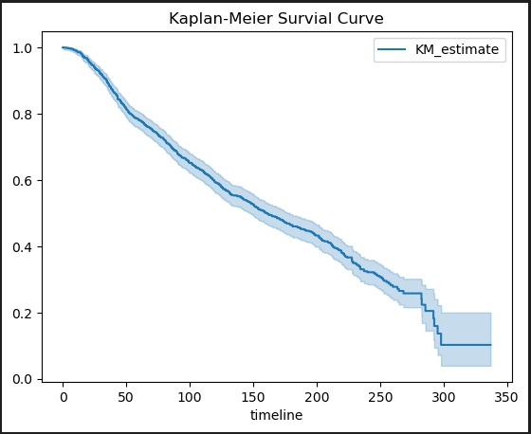
Survival Analysis
Used to analyze time-to-event data
Helps estimate probability of survival over time
Key Techniques:
Kaplan–Meier Survival Curves
Log-rank Test
Cox Proportional Hazards Model

Slide 8
Learning Models
Machine Learning Models
Model Training Process
Used to predict 10-year mortality risk:
Logistic Regression
Random Forest
Gradient Boosting / XGBoost
Train-test split
Cross-validation
Hyperparameter tuning
Performance comparison across models

Slide 9
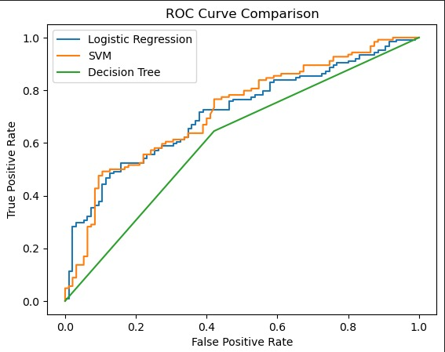
Evaluation Metrics
Accuracy
Precision & Recall
F1-Score
ROC Curve & AUC
Concordance Index (for survival models)

Slide 10
Conclusion & Future Work
Successfully developed survival and ML models
Identified major factors influencing breast cancer survival
Models can assist in predicting 10-year mortality risk
Potential to improve personalized cancer care
Use larger and multi-center datasets
Incorporate genetic and imaging data
Deploy as a clinical decision-support tool
Improve model explainability (SHAP, LIME)

Slide 11
Questions ?

Slide 12
Thank You!

